Slide 1
Redox Recap

Slide 2
Starter Questions
1. What does OIL RIG stand for?
2. What is an oxidising agent?
3. What is a reducing agent?
4. What are the oxidation states of each of the elements/ions the following:
H₂ Li O₂ NaCl MgCl₂ HClO BF₃ H₂O₂ H₂SO₄
H₂SO₄ SO₂ H₃PO₄ CuO CuSO₄ Fe₂O₃ FeO NaH Li₂O
5. Write 2 half equations and the full equation for magnesium burning in air to give magnesium oxide.
Half equation 1:
Half equation 2:
Full equation:
What species has been oxidised?
What species has been reduced?
What species is the oxidising agent?
What species is the reducing agent?

Slide 3
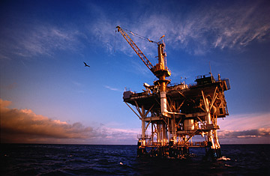
OIL RIG

Slide 4
Oxidising Agents and Reducing Agents
Oxidising agent:
A substance that can OXIDISE another substance (an electron acceptor)
Reducing agent:
A substance that can REDUCE another substance (an electron donor)
Notes:
RAD = Reducing Agents Donate
OAT = Oxidising Agents Take (accept)

Slide 5
You can work these out because some elements have FIXED OXIDATION STATES
Element | Oxidation state in compounds and ions | Exceptions
H | +1 | -1 in METAL HYDRIDES e.g., NaH
Li, Na, K | +1
Mg, Ca ,Ba | +2
Al | +3
F | -1
Cl | -1 | NOT 1- when combined with F or O
O | -2 | NOT -2 when combined with F -1 in peroxides (H₂O₂)

Slide 6
Standard Electrode Potential

Slide 7
Standard Electrode Potential Intro
Redox reactions
Reactions are ALWAYS equilibrium
Measuring how easy it is for metals to release their electrons into a solution
Look at the potential difference between the metal and the metal solution
Compare it to another metal and the metal solution
Potential difference between the metal and metal solution is known as absolute potential difference
Unable to do this!
Have to create a reference electrode
Measure the difference in potential between this reference electrode and the metal electrode.

Slide 8
The standard hydrogen electrode
Reference
Hydrogen gas
Pressure – 100kPa (1 bar)
Bubbling over a piece of platinum – surface is porous (allows large surface area and equilibrium between hydrogen ions in the solution and hydrogen gas to establish quickly).
Dipped into a solution of HCl or H₂SO₄
Hydrogen ion concentration of 1 moldm⁻³
Temperature – 298K
Standard conditions

Slide 9
Compare all reactions to…
H⁺ (aq) + e⁻ ↔ 1/2 H₂ (g)

Slide 10
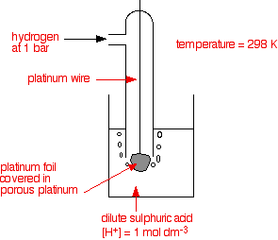

Slide 11
What conditions are required for a standard hydrogen electrode?

Slide 12
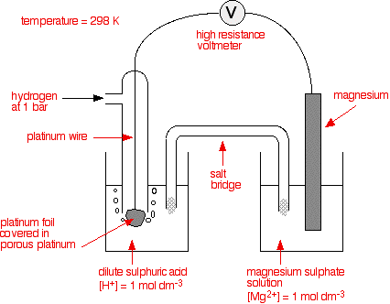
Measuring a standard electrode potential
Conc. sol KNO₃ –liquid or gel. Allows the movement of ions
Half cell
Half cell

Slide 13
Measuring a standard electrode potential
Want no flow of electrons around the external circuit → tell the difference in potential between both half cells when both reactions are in equilibrium.

Slide 14
Equations
H⁺ (aq) + e⁻ ↔ ½ H₂ (g)
Mg²⁺ (aq) + 2e⁻ ↔ Mg (s)

Slide 15
WHAT DO POSITIVE AND NEGATIVE STANDARD ELECTRODE POTENTIALS MEAN?

Slide 16
Equations
H⁺ (aq) + e⁻ ↔ ½ H₂ (g) E° = 0.00V
Mg²⁺ (aq) + 2e⁻ ↔ Mg (s) E° = -2.37V
Cu²⁺ (aq) + 2e⁻ ↔ Cu (s) E° = +0.34V

Slide 17
What the values mean…
Negative sign indicates the equilibrium position of the reaction is further to the left than the equilibrium position of the reaction in the hydrogen electrode
This means it releases electrons more readily than hydrogen
Positive sign indicates the equilibrium position of this reaction is further to the right than the equilibrium position of the reaction in the hydrogen electrode.
This means it releases electrons less readily than hydrogen.

Slide 18
Equations
Which is the best reducing agent and why?
H⁺ (aq) + e⁻ ↔ ½ H₂ (g) E° = 0.00V
Mg²⁺ (aq) + 2e⁻ ↔ Mg (s) E° = -2.37V
Cu²⁺ (aq) + 2e⁻ ↔ Cu (s) E° = +0.34V

Slide 19
Electromotive force (emf)
The potential difference is measured when no electrons are flowing through the external circuit.
The potential difference measured under these conditions is called electromotive force (emf) of the cell.
The symbol is E° _{cell}
Sometimes it is called standard cell potential.

Slide 20
Definition
The standard electrode potential of a half-cell is the emf of a cell containing the half-cell connected to the standard hydrogen electrode. Standard conditions of 298K, 100kPa pressure of gases and solution concentrations of 1 moldm⁻³ apply.

Slide 21
How would you measure the standard electrode potential of the following redox system?
1/2 Cl₂ (g) + e⁻ ↔ Cl⁻ (aq)

Slide 22
How would you measure the standard electrode potential of the following redox system?
1/2 Cl₂ (g) + e⁻ ↔ Cl⁻ (aq)
E° = +1.36V

Slide 23
How would you measure the standard electrode potential of the following redox system?
Fe³⁺(aq) ꓲ Fe²⁺ (aq)

Slide 24
Pages 88 and 89

