Slide 1
Storage cells and fuel cells
Do now:
What is a battery?
Name as many types and uses of batteries as you can.
Notes:
Draw primary cell and fuel cell by hand when explaining – easier for pupils to understand.

Slide 2
Commercial cells
Battery is 2 or more cells connected in series.
Batteries are types of electrochemical cells that provide the electricity that we use to power items (mobile phones, watches etc)
3 main types of commercial electrochemical cells:
Primary cells: non-rechargeable and thrown away after they run down.
Secondary cells: can be recharged after they run down.
Fuel cells: produces electricity from gaseous or liquid fuels.

Slide 3
2. Storage Cells – Secondary Cells
In non-rechargeable (primary) cells, the chemicals are used up so the voltage drops.
In rechargeable (secondary) cells the reactions are reversible – they are reversed by applying an external current
The current passes through in the opposite direction to the flow of current generated by the cell.
It is important that the products from the forward reaction stick to the electrodes and are not dispersed into the electrolyte.

Slide 4
2. Rechargeable (secondary) cells Nickel/Cadmium (Nicads)
-0.88 V Cd(OH)₂ (s) + 2 e⁻ ↔ Cd (s) + 2 OH⁻ (aq)
+0.52 V NiO(OH) (s) + H₂O (l) + e⁻ ↔ Ni(OH)₂ (s) + OH⁻ (aq)
Determine: the cell emf
What is the major disadvantage of this storage cell?
Notes:
Most common cell in eveyrday use.
P.d. Of1.2V (slightly less than pd of zinc-carbon cells and alkaline dry cells.
Anode: Cadmium
Cathode from nickel(III) hydroxide
Electrolyte: KOH
Anode reactions:
Charging: Cd(OH)₂ (s) + 2 e⁻ ↔ Cd (s) + 2 OH⁻ (aq)
Cathode reactions:
Discharging: Ni(OH)₃ + 2 H₂O + 2 e⁻ ↔ Ni(OH)₂ + 2 OH⁻

Slide 5
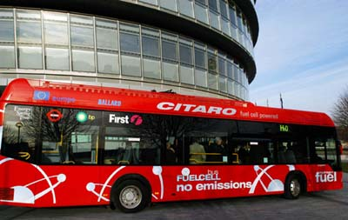
3. Fuel Cells
+0.40 V O₂ (g) + 4H⁺ (aq) + 4 e⁻ ↔ 2H₂O (l)
-0.83 V 2 H⁺ (aq) + 2 e⁻ ↔ H₂ (g)
Acidic Fuel Cell
Determine: a) cell emf b) overall reaction
Notes:
Anode reaction:
H₂ (g) ↔ 2 H⁺ (aq) + 2 e⁻
Oxidation of hydrogen is catalysed by the layer of Pt.
The e- released by this reaction flow through the external circuit.
The H+ ions pass through the proton exchange membrane to the cathode
Cathode reaction:
Oxygen is reduced to water vapour.
It reacts with the H+ ions that pass through the proton exchange membrane to the cathode.
Overall:
2H₂(g) + O₂(g) → 2H₂O(g)
Efficiency of a fuel cell is typically about 40% depending on the sign and the fuel used.

Slide 6
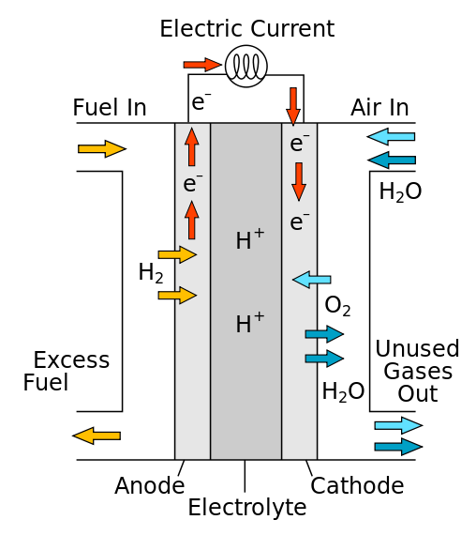
3. Fuel Cells The hydrogen-oxygen fuel cell

Slide 7
https://www.youtube.com/watch?v=imV_ufIzxPY

Slide 8
3. Fuel Cells The hydrogen-oxygen fuel cell
Chemicals stored separately outside the cell and fed in when electricity is required
Alkaline hydrogen-oxygen fuel cell – powers electrical vehicles
H₂ and O₂ gas fed into 2 separate Pt containing electrodes
Electrodes separated by anion-exchange membrane that allows OH⁻ and H₂O to pass through
Does NOT allow H₂ and O₂ gas to pass through
Electrolyte = aqueous KOH solution
Equations:
Positive electrode: ½ O₂ (g) + 2H⁺ (aq) + 2e⁻ → H₂O (l)
Negative electrode: H₂ (g) + 2OH⁻ (aq) → 2H₂O (l) + 2e⁻
Overall: H₂(g) + ½ O₂(g) → H₂O(l)
Notes:
Draw diagram on board and annotate

Slide 9
What do you think the advantages and disadvantages of fuel cells are?

Slide 10
Pros & cons of fuel cells
+ More efficient than internal combustion engine
+ water is only product (no toxic chemicals, no CO₂ emissions from the cell itself)
– Need energy to produce O₂ and H₂ – electrolysis of H₂O (re-use the waste product of the fuel cell – requires electricity – burning fossil fuels – NOT carbon neutral)
– most H₂ is made using fossil fuels, fuels cells expensive, hydrogen is highly flammable – difficult to store and handle safely

