Slide 1
Do Now - Ions Test

Slide 2
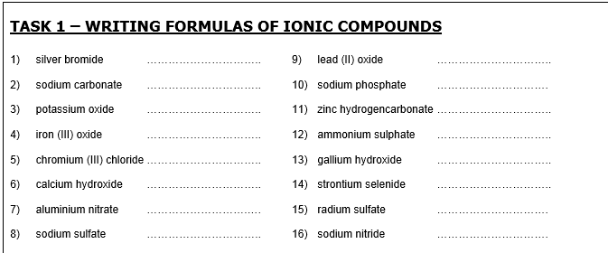
Formulas and Equations
Some Common Ions:
Using the table to the right and the PT
Write formulas for ...
Silver hydroxide
Potassium sulfide
Aluminium oxide
Iron (II) phosphate
Iron (III) phosphate
Positive Ions |  | Negative Ions
H | Al | H | OH
Li | Ag | F | NO₃
Na | Zn | Cl | HCO₃
K | NH₄ | Br | CO₃
Ca |  | I | SO₄
Mg |  | S | PO₄
Ba |  | O
Write general equations for:
Acid + alkali →
Acid + metal oxide →
Acid +metal hydroxide →
Acid + metal carbonate →
Acid + metal hydrogencarbonate →
Acid +metal →
Metal + oxygen →
Metal carbonate →
Metal + water →
Ammonia + acid →
TASK 2 - Complete the equations:
Hydrochloric acid + sodium hydroxide →
Nitric acid + magnesium oxide →
Sulfuric acid + potassium hydroxide →
Hydrochloric acid + calcium carbonate →
Nitric acid + sodium hydrogencarbonate →
Sulfuric acid + magnesium →
Magneisum + oxygen →
Calcuium carbonate →
Sodium + water →
Ammonia + hydrochloric acid→

Slide 3
Write general equations for:
Acid + alkali → salt + water
Acid + metal oxide → salt + water
Acid +metal hydroxide → salt + water
Acid + metal carbonate → salt + carbon dioxide + water
Acid + metal hydrogencarbonate → salt + carbon dioxide + water
Acid +metal → salt + hydrogen
Metal + oxygen → metal oxide
Metal carbonate → metal oxide + carbon dioxide
Metal + water → metal hydroxide + hydrogen
Ammonia + acid → ammonium salt

Slide 4
TASK 2 - Complete the equations:
Hydrochloric acid + sodium hydroxide → sodium chloride + water
Nitric acid + magnesium oxide → magnesium nitrate + water
Sulfuric acid + potassium hydroxide → potassium sulfate + water
Hydrochloric acid + calcium carbonate → calcium chloride + carbon dioxide + water
Nitric acid + sodium hydrogencarbonate → sodium nitrate + carbon dioxide + water
Sulfuric acid + magnesium → magnesium sulfate + hydrogen
Magneisum + oxygen → magnesium oxide
Calcuium carbonate → calcium oxide + carbon dioxide
Sodium + water → sodium hydroxide + hydrogen
Ammonia + hydrochloric acid→ ammonium chloride

Slide 5
Balancing Equations
Recap of balancing:
Hydrochloric acid + magnesium hydroxide
TASK: balance these
1) Ca + O₂ → CaO
2) Na₂O + H₂O → NaOH
3) Al + O₂ → Al₂O₃
4) Na + Cl₂ → NaCl
5) Na₂CO₃ → Na₂O + CO₂
6) K + O₂ → K₂O
7) C₄H₈ + O₂ → CO₂ + H₂O
8) Fe₂O₃ + HCl → FeCl₃ + H₂O
9) F₂ + KBr → KF + Br₂
10) C₅H₁₂ + O₂ → CO₂ + H₂O
11) NH₃ + O₂ → NO + H₂O
12) HNO₃ → NO₂ + H₂O + O₂

Slide 6
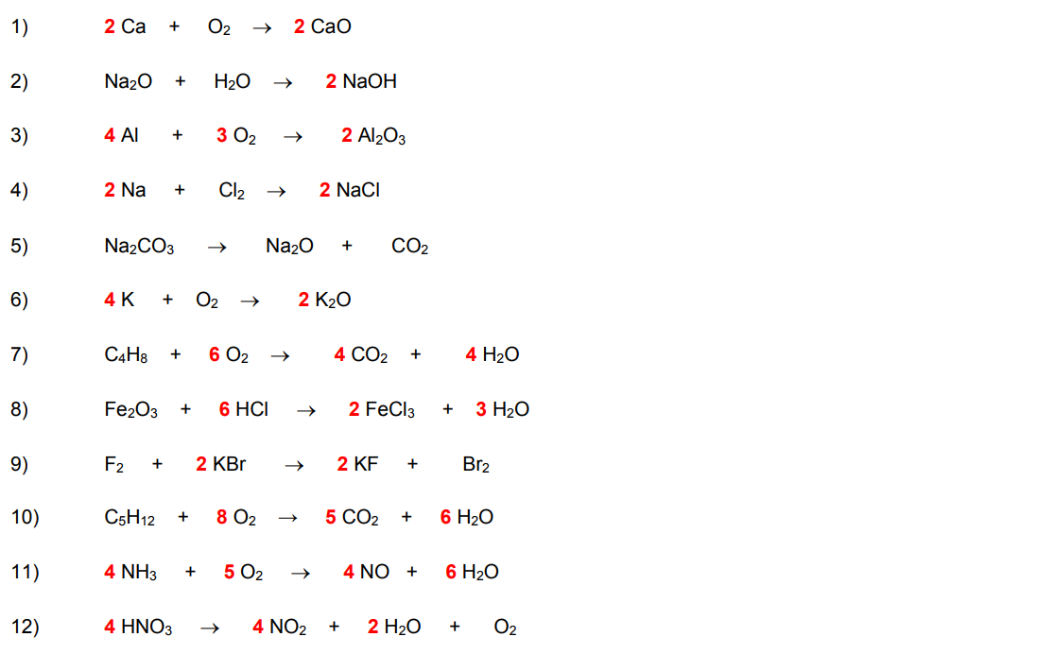

Slide 7
SIGNIFICANT FIGURES

Slide 8
General Rules
Usually give answers to 3 significant figures (unless stated otherwise)
(BUT it is best to keep the whole number in your calculator during calculations)
Give M_{r} to 1 decimal place
NB: you cannot be more accurate in your answer than the number of decimals or significant figures in the question

Slide 9
Significant Figures: Rules
1. All non-zero digits ARE significant
E.g.,
312 = 3 sig figs
3124 = 4 sig figs
283.592 = 6 sig figs
2. Zeros occurring between numbers ARE significant
E.g.,
6003 = 4 sig figs
201 = 3 sig figs
98908 = 5 sig figs

Slide 10
Significant Figures: Rules
4. In decimals, zeros AFTER the non-zero digits ARE significant
E.g.,
8.00 = 3 sig figs
99.0000 = 6 sig figs
10.00 = 4 sig figs
5. In decimals, zeros BEFORE the non-zero digits ARE NOT significant
E.g.,
0.009 = 1 sig figs
0.01 = 1 sig figs
0.010 = 2 sig figs
0.01094 = 4 sig figs

Slide 11
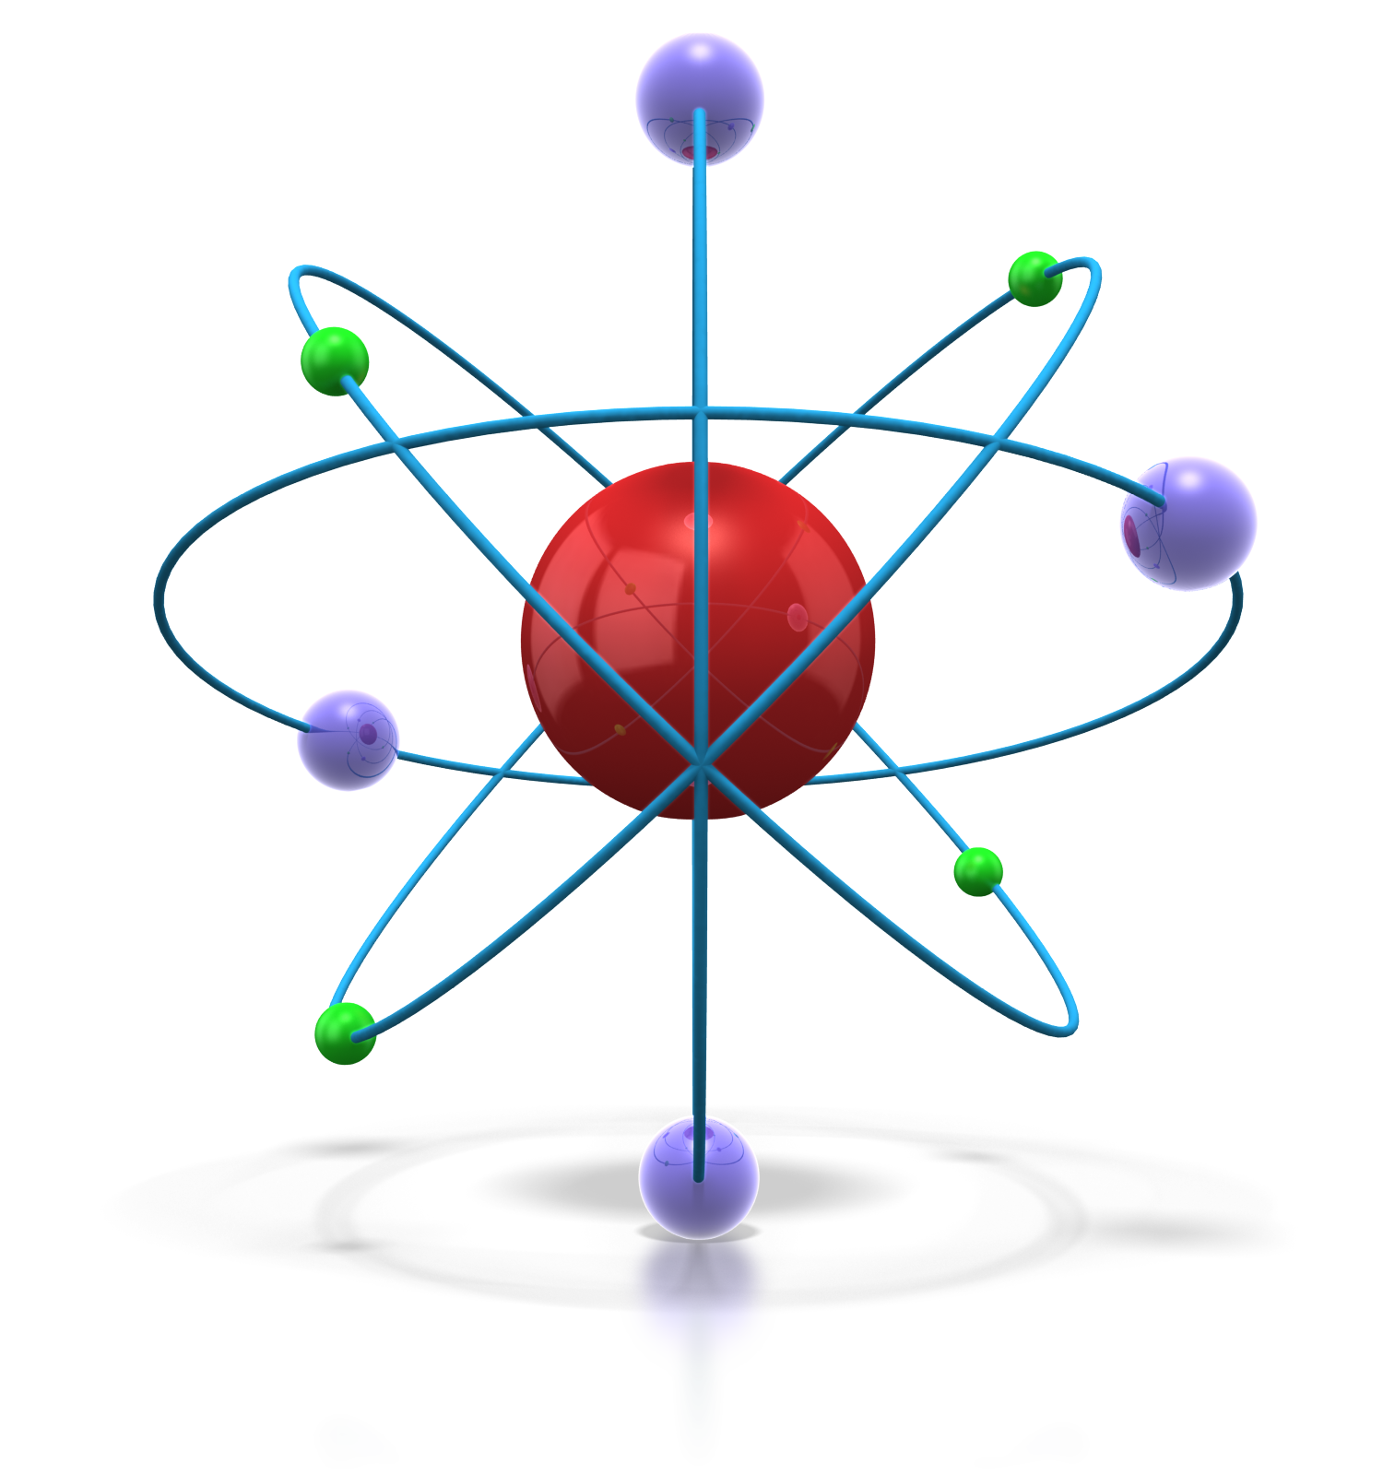
Standard Form
In standard form, a number is always written as:
A × 10^{n}
A is always between 1 and 10
n tells us how many places to move the decimal point.
Example 1: Write 15 000 000 in standard form
1.50 x 10⁷
Example 2: Write 0.00547 in standard form
5.47 x 10⁻³
Write the following in standard form:
30 000
3.00 x 10⁴
0.000467
4.67 × 10⁻⁴
Tip :
Use the “EXP” and “(-)” buttons on your calculator for standard form.
What are the following numbers in non-standard form?
5.149x10⁶
7.17x10⁻⁵

Slide 12
Significant Figures Worksheet

Slide 13
Measuring Amounts
Write down what unit each amount is measured in.
Mass:
Volume:
Concentration:

Slide 14
Measuring Amounts
Write down what each amount is measured in.
Mass = grams (g) or
      kilograms (kg)
Volume = cubic centimetres (cm³) or cubic decimetres (dm³)
Concentration = grams per dm³ (gdm⁻³) or moles per dm³ (mol dm⁻³)

Slide 15
Converting Units
How many grams are in 2 kilograms?
How many kilograms are in 5600 grams?
How many kilograms are in 32 grams?
How many grams are in 0.67 kilograms?
How many grams are in 0.0032 kilograms?
How many kilograms are in 532896 grams?

Slide 16
Converting Units
How many grams are in 2 kilograms? 2000 g
How many kilograms are in 5600 grams? 5.6 kg
How many kilograms are in 32 grams? 0.032 kg
How many grams are in 0.67 kilograms? 670 g
How many grams are in 0.0032 kilograms? 3.2 g
How many kilograms are in 532896 grams? 532.896 kg

Slide 17
Converting Units
Express the following volumes in dm³:
2000cm³
0.05m³
2cm³
Express the following volumes in cm³:
0.0023dm³
8.2dm³
0.000723dm³
REMEMBER:
1dm³ = 1000cm³ = 1/1000m³

Slide 18
Converting Units
Express the following volumes in dm³:
2000cm³ 2dm³
0.05m³ 50dm³
2cm³ 2 x 10⁻³dm³
Express the following volumes in cm³:
0.0023dm³ 23cm³
8.2dm³ 8200cm³
0.000723dm³ 0.723cm³

Slide 19
Converting Units
Convert 250cm³ into moldm⁻³
Convert 2 litres into moldm⁻³
Convert 0.1 moldm⁻³ into cm³
Convert 500 cm³ into moldm⁻³?
What is 10 cm³ in moldm⁻³?
REMEMBER: 1 moldm⁻³ = 1L

Slide 20
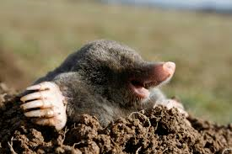
Notes:
Teacher notes
In ‘Slide Show’ mode, click the name of a section to jump straight to that slide.

Slide 21
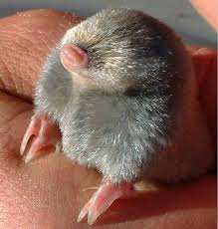
The Mole
A mole is a unit just as the gram is a unit; its symbol is mol.
A mole is defined in terms of carbon-12, which is the reference standard:
1 mole is the amount of substance that contains as many particles as there are atoms in exactly 12g of carbon-12.

Slide 22
How many atoms are there in 12g of carbon-12?
602300000000000000000000
atoms!!!!
Or in simple terms……
6.02 x 10²³
Avogadro’s number, L
This many particles of anything = 1 mole
Notes:
NB – textbook states 6.022x10²³

Slide 23
Mole calculations
Mole = mass
    Mr
    Rearrange:

Slide 24
Moles Questions
How many moles are there in 16g sulphur?
What mass of iron must be weighed out to obtain 3 moles?
How many moles are there in 0.12g of carbon?

Slide 25
Moles Questions
How many moles are there in 16g sulphur? 16/32.1 = 0.5 mol
What mass of iron must be weighed out to obtain 3 moles? 3x55.8=167.4g
How many moles are there in 0.12g of carbon? 0.12/12=0.01g

Slide 26
Molar Mass
The mass per mole of a substance (i.e., the mass of 1 mole)
Unit = g mol⁻¹
Numerically the same as Mr
1 mole of an element = the relative atomic mass in grams
56g of iron
32g of sulphur
12g of carbon

Slide 27
What is the molar mass?
MgO
CO₂
CuCO₃
CuO
HNO₃
6. NH₃
7. NaOH
8. (NH₄)₂SO₄
9. H₂SO₄

Slide 28
What is the molar mass?
MgO 40.3
CO₂ 44.0
CuCO₃ 123.5
CuO 79.5
HNO₃ 63.0
6. NH₃ 17.0
7. NaOH 40.0
8. (NH₄)₂SO₄ 132.1
9. H₂SO₄ 98.1

Slide 29
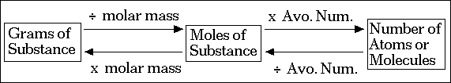
Converting moles
Mole = mass Mr
Avogadro’s number = no of atoms or molecules in 1 mole

Slide 30
Using Avogadro’ Number
Q1. 0.450 moles of Fe contains how many atoms?
Q2. 0.200 mole of H₂O contains how many molecules?
Notes:
Q1 - multiply by Avogadro's Number.
0.450 mol x 6.022 x 10²³ mol¯¹
Q2. multiply by Avogadro's Number.
0.200 mol x 6.022 x 10²³ mol¯¹

Slide 31
Using Avogadro’ Number: read the question carefully!!
Q3. 0.450 g of Fe contains how many atoms?
Q4. 0.200 g of H₂O contains how many molecules?
Notes:
Q3. Step One: 0.450 g divided by 55.85 g/mol = 0.00806 mol
Step Two: 0.00806 mol x 6.022 x 10²³ atoms/mol
Q4. Step One: 0.200 g divided by 18.0 g/mol = 0.0111 mol
Step Two: 0.0111 mol x 6.022 x 10²³ molecules/mol

Slide 32
More calculations:
1) Calculate the number of molecules in 1.058 mol of H₂O
2) Calculate the number of atoms in 0.750 mol of Fe
3) Calculate the number of molecules in 1.058 g of H₂O
4) Calculate the number of atoms in 0.750 g of Fe
5) Which contains more molecules: 10.0 g of O₂ or 50.0 grams of iodine, I₂?
EXT: 6) A solution of ammonia and water contains 2.10 x 10²⁵ water molecules and 8.10 x 10²⁴ ammonia molecules. How many total hydrogen atoms are in this solution?
Notes:
1.058 mole x 6.022 x 10²³ molecules/mole
2) 0.750 mole x 6.022 x 10²³ atoms/mole
3) 1.058 gram divided by 18.0 g/mol) x 6.022 x 10²³ molecules/mole
4) (0.750 gram divided by 55.85 g/mole) x 6.022 x 10²³atoms/mole
5) Basically, this is just two two-step problems in one sentence. Convert each gram value to its mole equivalent. Then, multiply the mole value by Avogadro's Number. Finally, compare these last two values and pick the larger value. That is the one with more molecules.
6) Ammonia's formula is NH₃ and water's is H₂O. Ammonia has three atoms of H per molecule and water has two atoms of H per molecule.
ammonia's contribution:
8.10 x 10²⁴ times 3 = 2.43 x 10²⁵ H atomswater's contribution:
2.10 x 10²⁵ times 2 = 4.20 x 10²⁵ H atomssum them up:
2.43 x 10²⁵ + 4.20 x 10²⁵ = 6.63 x 10²⁵ H atoms

Slide 33
Multiple choice 1
Which of the following pure iron samples contains the largest number of atoms?
a. 6.70 g
b. 0.110 mole
c. 7.83 x 10²² atoms
Notes:
6.70/55.8 x 6.023x10²³ =
0.110 x 6.023x10²³ =
7.83x10²²

Slide 34
Multiple choice 2 – next
Which of the following contains the most chloride ions?
A 10 cm³ of 3.30 × 10⁻² mol dm⁻³ aluminium chloride solution
B 20 cm³ of 5.00 × 10⁻² mol dm⁻³ calcium chloride solution
C 30 cm³ of 3.30 × 10⁻² mol dm⁻³ hydrochloric acid
D 40 cm³ of 2.50 × 10⁻² mol dm⁻³ sodium chloride solution
Notes:
B

